Slide 1

H1B VISA Prediction Engine
Akhil Ranjan, Jianghong Man, Stephanie Liu, Ziqing Wang, Kucina Li, Yixiao Yang
Notes:
JASKYZ

Slide 2


Slide 3
Agenda
Findings and Strategies & Future Blueprint
Executive Summary
Data Preprocessing
Exploratory Data Analysis
Modelling
Notes:
Exploratory Data Analysis, Data Preprocessing

Slide 4


Slide 5

Executive Summary
Background: Our objective was to explore the trends of the recruiting of international students. We were hired by a global talent acquisition consulting firm on meeting the clients’ requirements to attract, engage and hire global talents.
Problem: Reviewing the general trends of international recruiting and categorize them the job titles into different domains and create a prediction model.

Slide 6
Business questions:
Which Employers submit the most number of H-1B visa applications?
What are the most common Job Titles applied for by the high applicant employers?
What occupations are more likely to qualify for an H-1 B visa?
What are the kinds of H-1 B visa categories and how they affect

Slide 7
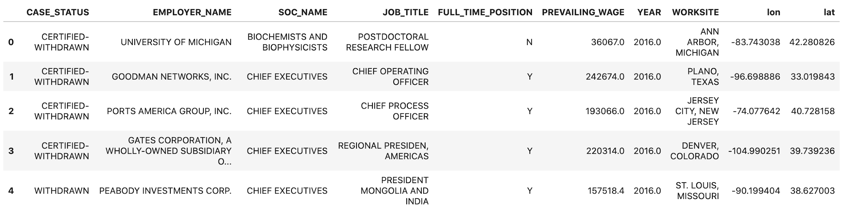
Data Exploration
H-1B petition data (2011-2016)
Approximately 3 million records
11 columns in the dataset
Notes:
There are 11 columns in the dataset, which includes Applicant’s ID, Case Status, Employer Name, Occupational Name, Job Title, Full-Time Position, Prevailing Wage, Year Filed, Worksite Position, Worksite Longitude, Worksite Latitude
Case Status: Status associated with the last significant event or decision. Valid values include Certified, Certified-Withdrawn, Denied, and Withdrawn.
Employer Name: Name of employer submitting labor condition application.
Occupational Name: Occupational name associated with the SOC CODE. SOC CODE is the occupational code associated with the job being requested for temporary labor condition, as classified by the Standard Occupational Classification (SOC) System.
Job Title: Title of the job.
Full-Time Position: Y = Full Time Position; N = Part Time Position.
Prevailing Wage: Prevailing Wage for the job being requested for temporary labor condition. The wage is listed at annual scale in USD. The prevailing wage for a job position is defined as the average wage paid to similarly employed workers in the requested occupation in the area of intended employment. The prevailing wage is based on the employer’s minimum requirements for the position.
Year Filed: Year in which the H-1B visa petition was filed. (2011-2016)
Worksite Position: City and State information of the foreign worker’s intended area of employment
LON: Longitude of the Worksite.
LAT: Latitude of the Worksite.

Slide 8
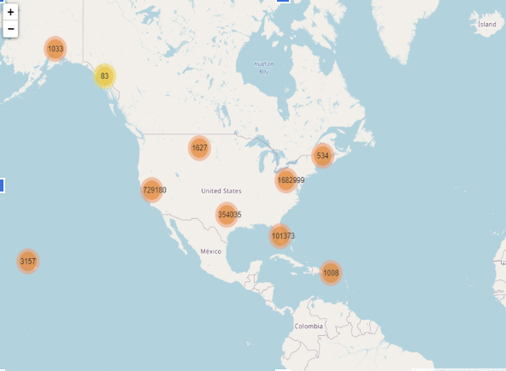
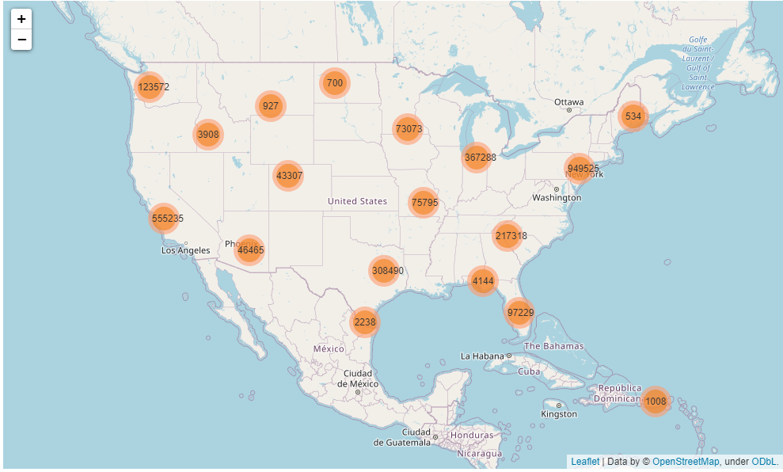
Geospatial
Worldwide
United States
Notes:
Points to say:
Insights:
3157= Honolulu
1023= Alaska
83= Alaska
1008= Puerto Rico
If you are interested, we can show you the interactive map highlighting the clusters of the job locations

Slide 9


Slide 10
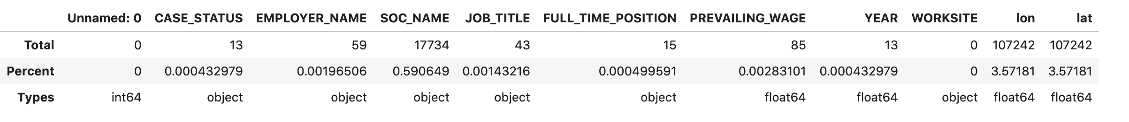
Overview of the Variables
Missing Data
Unique Values
Notes:
First, let’s take a overview of the variables. According to the top graph, we can see that the dataset is pretty clean because there are few missing values except for the soc_name and location’s longitude and latitude. So, we decide to drop those related rows since the missing values only contain less than 0.001%.
According to the bottom graph, we can see how many unique values for each column

Slide 11
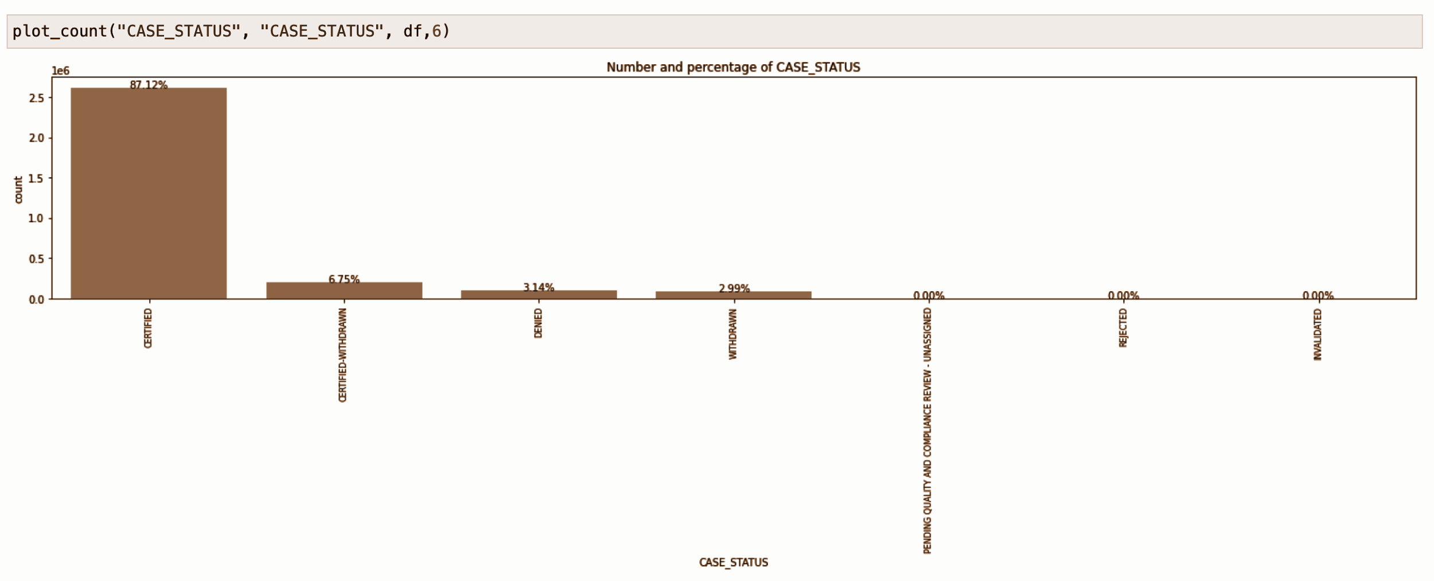
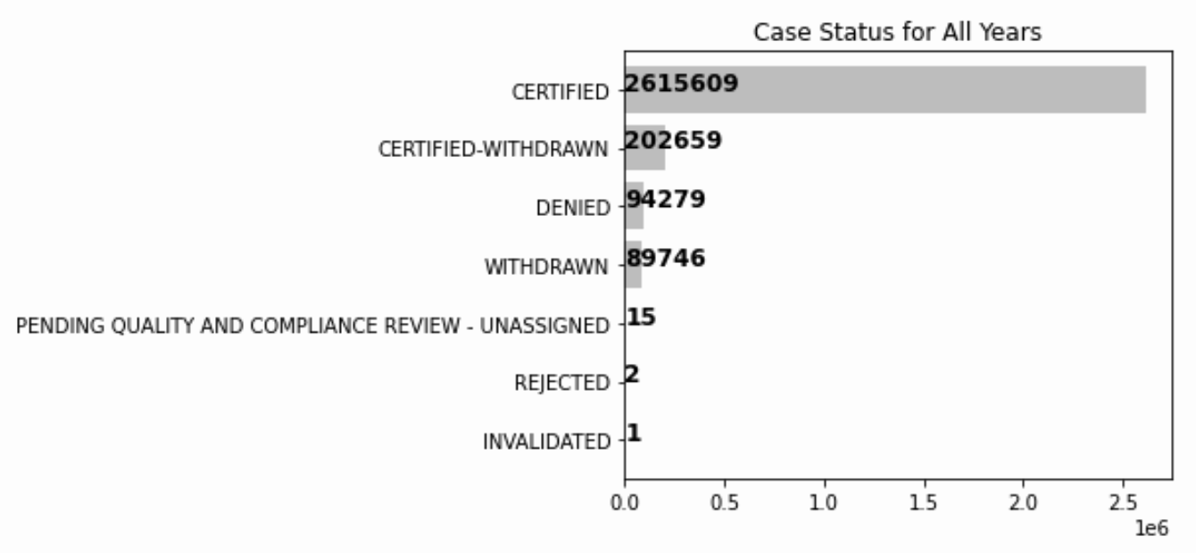
Case_status
certified-withdrawn -> certified
withdrawn, pending quality and compliance review-unassigned, rejected, invalidated -> denied
Notes:
Moving on to the columns in our dataset, we treat each variable separately.
First, as we can see in the graph, we have detailed classifications in the original dataset. Since we only need to know whether a claim was certified or denied, we further categorized this variable and keep only two status for further modeling part (certified-withdraw -> certified, drop withdraw, pending -> denied, rejected -> denied, invalidated -> denied)

Slide 12
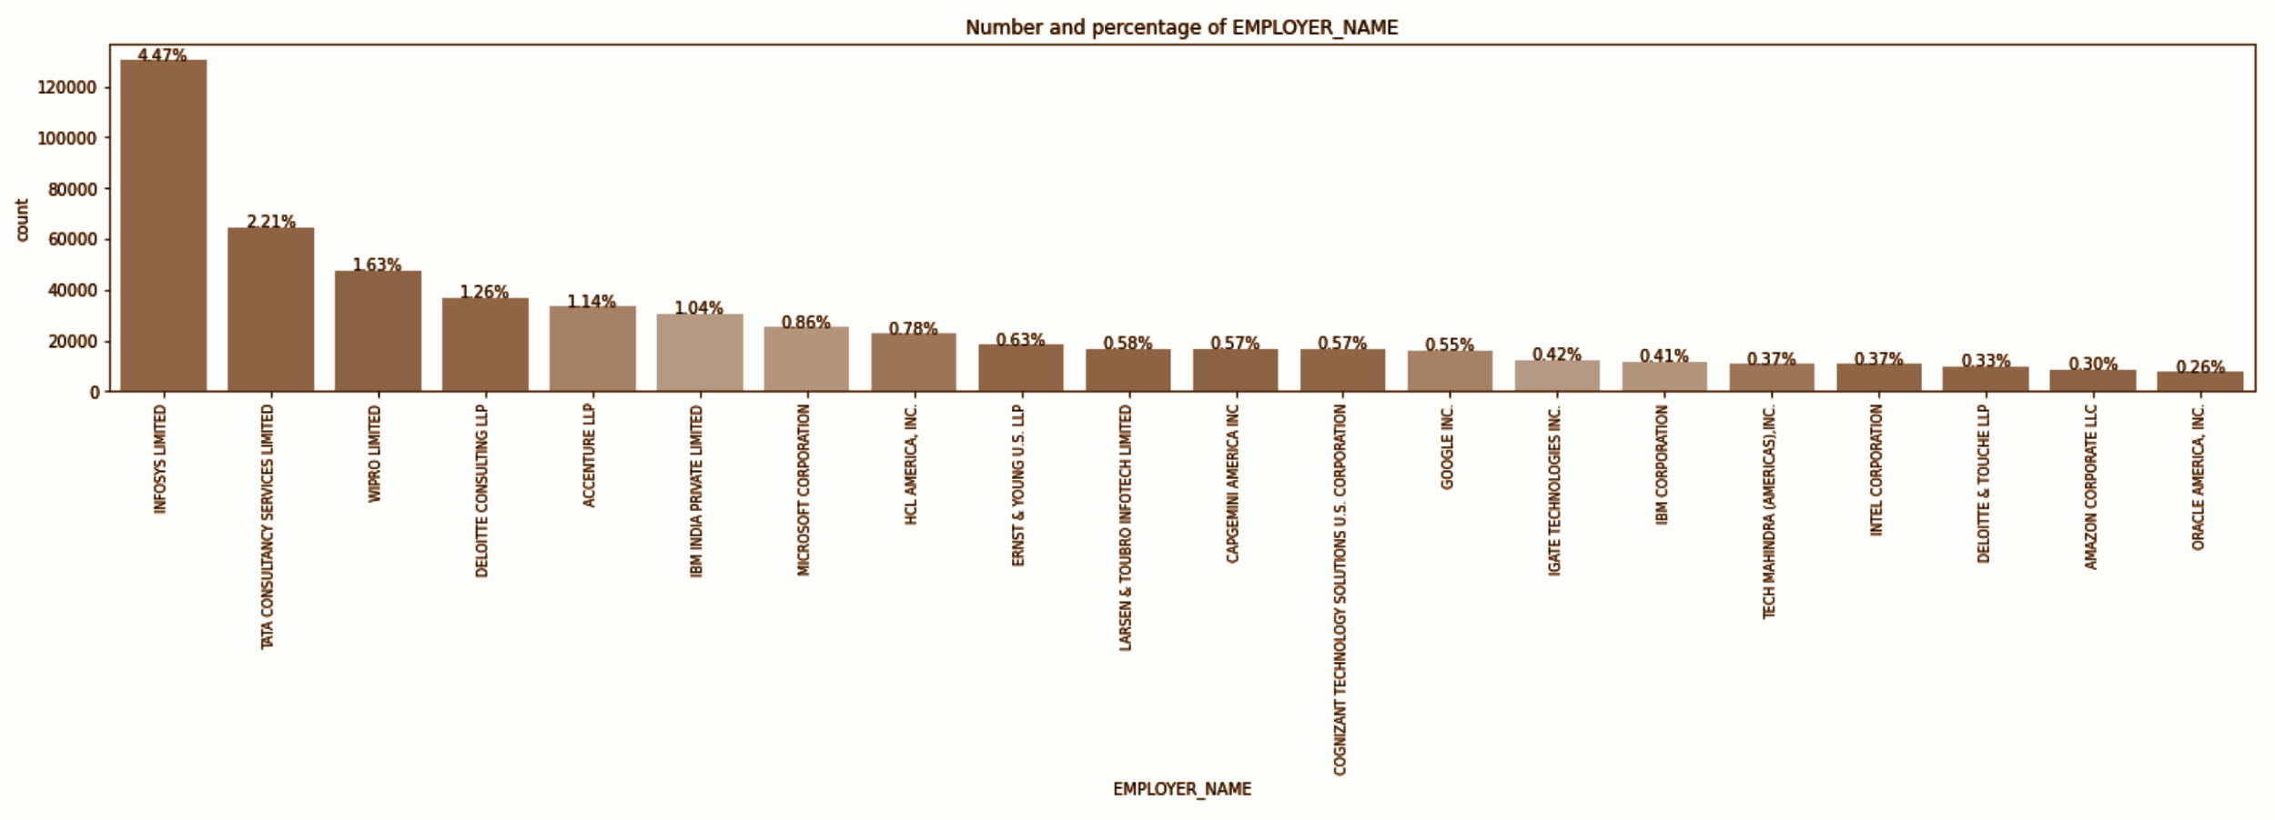
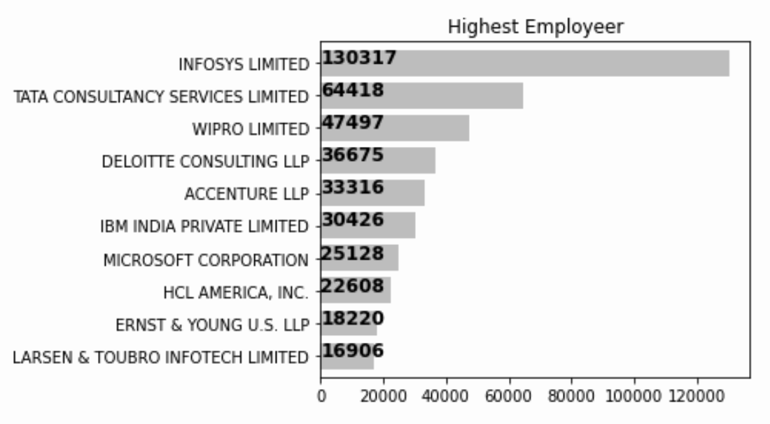
Employer_name
INFOSYS LIMITED company sent the most claims for H1B Visa
Notes:
Moving on to the employer_name, here are the two graphs showing how many claims each company sent over the past 6 years. Since there are about 236000 unique companies in our dataset and most of the companies has very few claims, then we decide to keep only the top 1000 companies, and label the rest 235000 companies as ‘other companies’ during the data cleaning process and order by the number of claims they issued in our analysis.

Slide 13
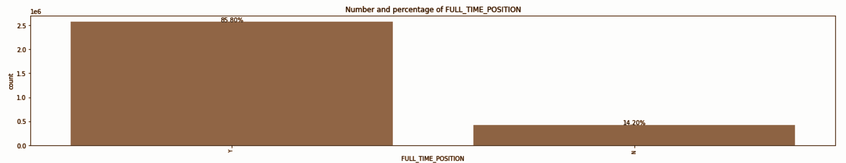
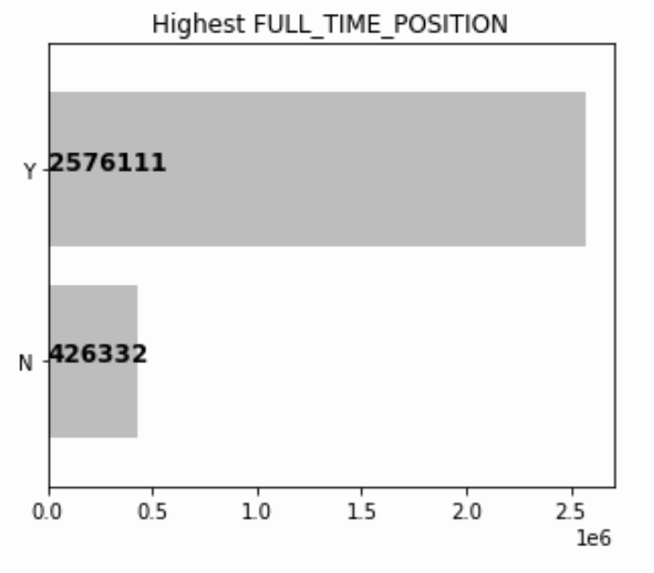
Full_time_position
85.8% of applicants has full-time position when they apply for H1B Visa
Notes:
Next, we have the full time position column which has two status, whether is full time or not as you can see the details in the graphs

Slide 14
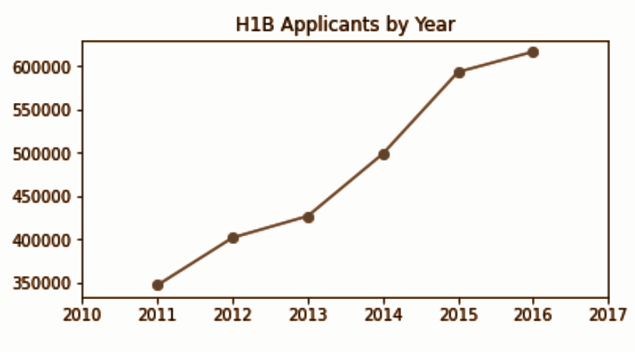
Year
Number of applicants increases
year by year from 2011 to 2016
Notes:
Moving on to the year variable, we can see that the number of applicants increases year by year from 2011 to 2016. We decide to treat year as a categorical variable instead of the numeric one in the further modeling part.

Slide 15
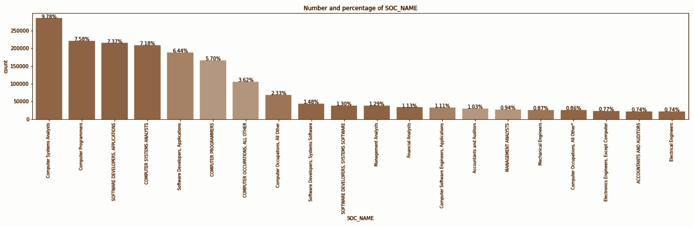
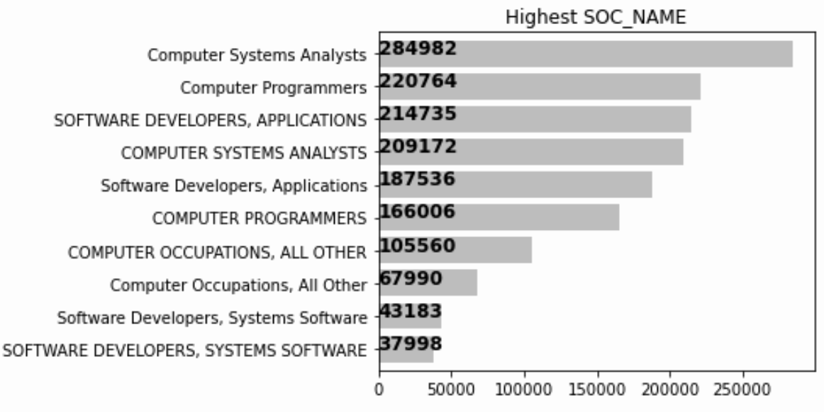
SOC_Name: Standard Occupational Classification
Notes:
Here is the visualization for the occupational industry. As you can see in the graph, the top 10 frequently issued claims are all from Information Technology Industry

Slide 16

SOC_Name
17702 Missing Values
1. Without
Soc_name,
but with
job_title
2. With
soc_name
Combine
&
Drop
Split and treat separately
Classify using the job_title
Classify using the soc_name
Combine 2 data frame and drop the original soc_name column
Programmers, system, computer -- IT
Financial, business -- Finance
Data, database -- Data
Sales, market, logistic -- SCM
Construction, architecture -- Estate
Public, fundraising -- PR
Education, law -- Administrative
Agricultural, farm -- Agri
Forensic, health -- Medical
Teachers -- Education
Notes:
However, we found that there are 17702 missing values in this column, which represent 0.59% of the total data. Thus, we decide to split and treat existing and null values separately. First, as to those without the soc_name but with the job title, we decide to dig some insights using the job title. We manually cluster some typical field to the corresponding industry. For instance, the cells including “programmers, system, and computer” are all classified to “IT” industry. Second, we also set the field to the resting rows with soc_name. For example, we classify “public and fundraising” to PR. Then, we combine those two dataframe together and drop the original soc_name. Now, we have the soc_name1 column in the new dataset.

Slide 17
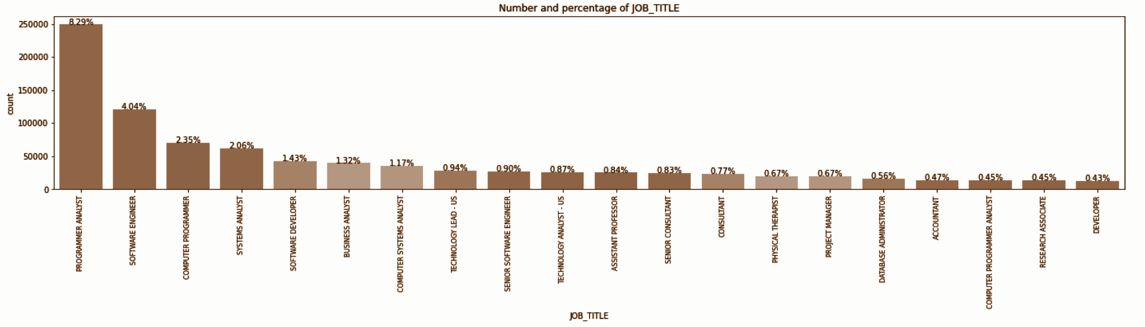
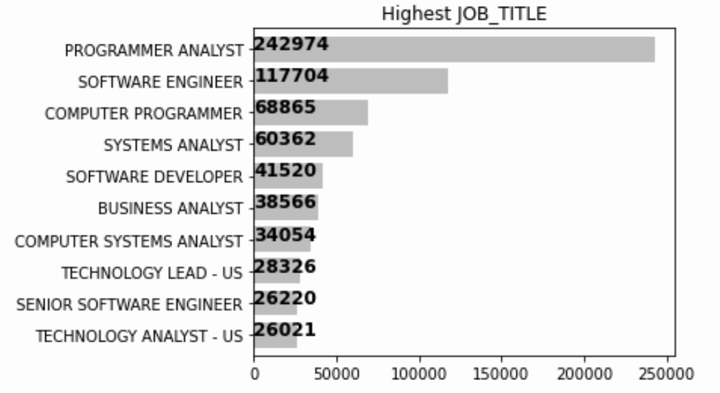
JOB_TITLE
Notes:
Moving on to the job title, we want to analysis the position of person in the company. We want to see whether the high ranking position will affect one person being accepted to H1B or not.

Slide 18

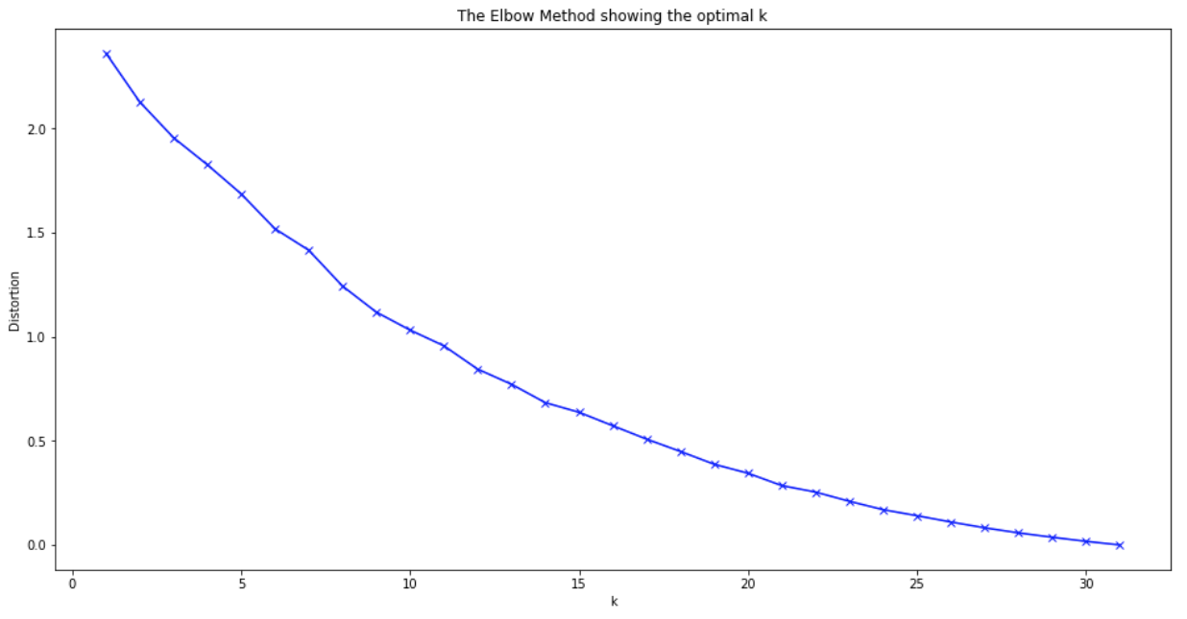
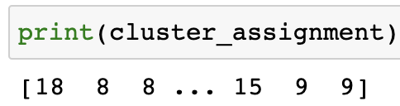
JOB_TITLE
SentenceTransformer.encode
Model: distilbert-base-nli-stsb-mean-tokens
STS benchmark: 85.16
Use Kmeans method to fit embeddings (K=20)
Assign the clustering result to each row
Drop the original “job_title” column
Only keep the numeric categorical data as “cluster_job_title” in the dataset
Notes:
We use sentence transformer method, which is a python framework for state of the art sentence and text embeddings. These enbeddings can then be compared, for instance, with cosine-similarity to find phrases with similar meaning. After representing the phrases as dense vectors, we put those to the unsupervised clustering method, kmeans clustering to categorize the job title. After 24 hours of hard working, we come up with the new column, “cluster_job_title”, including 20 clusters of work position.

Slide 19
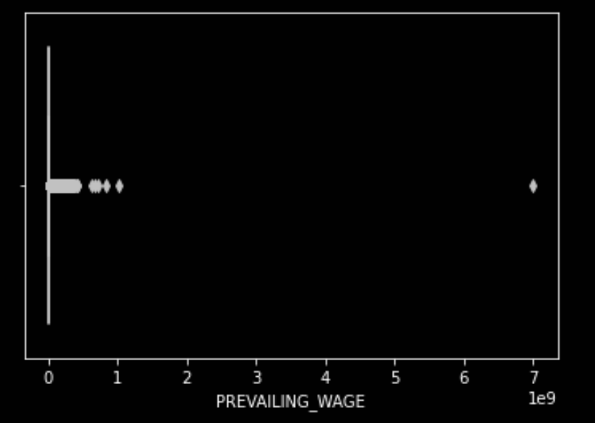

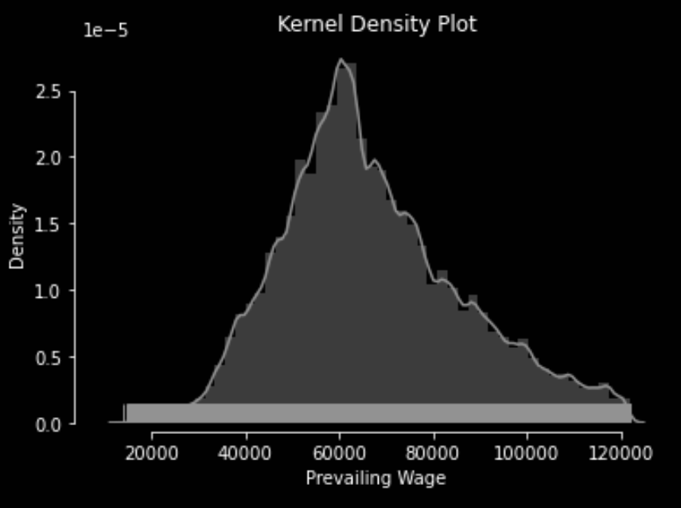
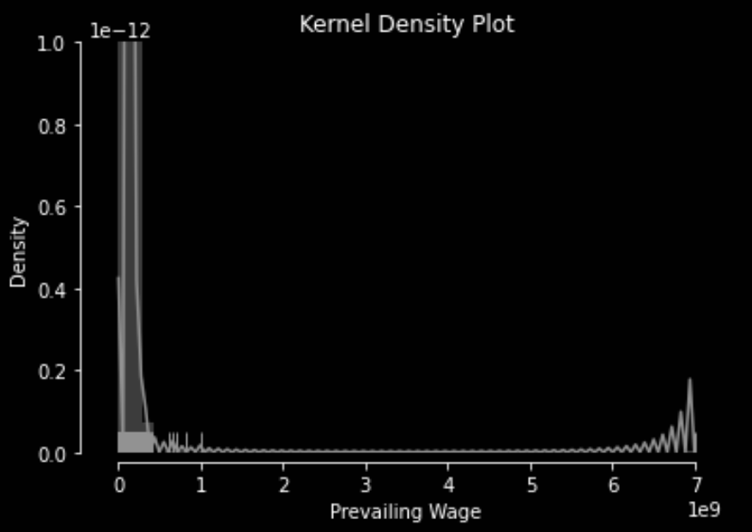
PREVAILING_WAGE
Keep only:
0.25 Quantile - 1.5 * interquartile range
0.75 Quantile + 1.5 * interquartile range
Notes:
Moving on to the numeric data, wages, we find the data has an extreme left skew. We keep only the middle range, which calculated above to mediate. Then, we have a distribution as the picture on the right, similar to the normal distribution

Slide 20
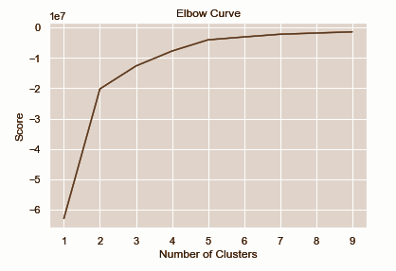
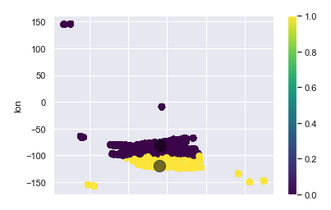
Worksite
First, kmeans clustering on lon & lat
Problem: only 2 clusters, not specific enough
Notes:
Then, we tried to cluster the working location using the unsupervised k means cluster. However, there are only 2 clear clusters as the graph showing above. We think that this method is not good enough, thus …

Slide 21
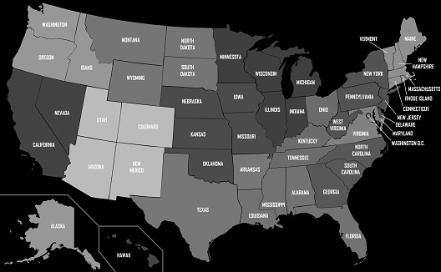
Worksite
1
2
Separate the worksite by ‘,’
Select state_split[1] as a separate “State” column
Eg: WORKSITE == ‘ANN ARBOR, MICHIGAN’
3
4
Drop “Worksite”, only keep the “State” column
Drop “longitude” and “latitude” to avoid duplicated info
Eg: State == ‘MICHIGAN’
Notes:
we only keep the state instead of the whole messy column. 52 states are included in here. We also drop the longitude and latitude in order to avoid the duplicated information

Slide 22
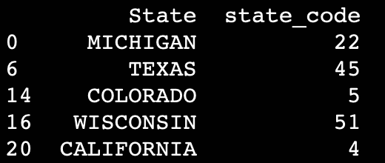


Deal with categorical values
Use “get_dummy” to get dummy variables for each variable
Use cat.code & save the corresponding code for further reference
Too large dataset
Running forever!
Eg: State
Notes:
Finally, we need to change the categorical values to numeric in order to put in our models. First, we try to get dummy variables for each column. It turns out we increased to 80 more columns. Unfortunately, our data is too large so that the computer crashed few times. Thus, we decide to use cat code for each column. We also saved the corresponding code for future usage.

Slide 23


Slide 24
Model Performance
Model | Training Accuracy | Testing Accuracy
Decision Tree | 0.948 | 0.866
Random Forest | 0.948 | 0.872
Gradient Boosting | 0.771 | 0.764
Logistic Regression | 0.586 | 0.532
Naive Bayesian | 0.719 | 0.665
Stochastic Gradient Descent | 0.589 | 0.915
Perceptron | 0.500 | 0.031
Decision Tree
- Easy to use and understand
- Works well for non-linear classification
Random Forest
- Limit overfitting
- Reduce variance
Gradient Boosting
- Lots of flexibility
- Performs well with unbalanced data
Notes:
---Firstly, talk about what models we tried, and based on their accuracy scores, we first choose 3 models to focus on, and briefly talk about random forest, focus on introduce about gradient boosting model; briefly mention why we choose random forest over decision tree
--later talk more details about why we finally choose random forest (I will cover this part)

Slide 25
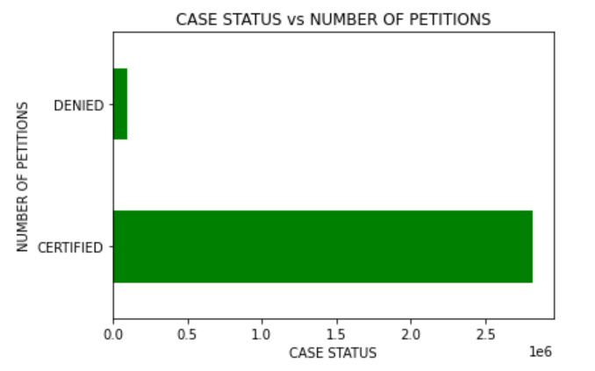
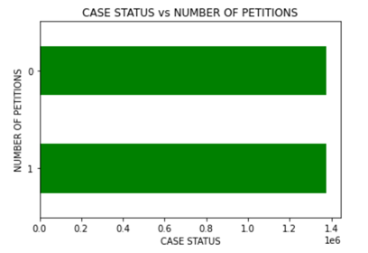
Modeling challenges: Solve unbalanced datasets
6.13%
93.87%
Notes:
--Split data: training data (training subset, and testing subset), holdout data as real world
--SMOTE() to solve unbalanced data (briefly talk about smote method and why it is good for our dataset)
--Binary label: cause problem (after we cleaned data again, we firstly had a really bad accuracy scores, awfully different from what we expected, the scores are even lower than 20%; we later figure out the reason: at first, certified is 1, but after re-clean data, certified refers to 0, it is flipped, which cause the problem.We change the label back to solve it)

Slide 26
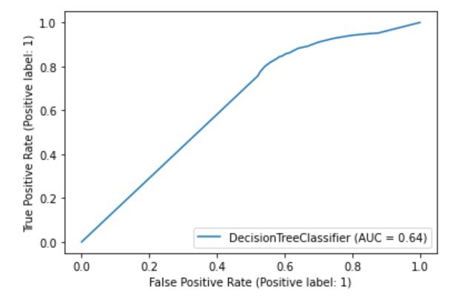
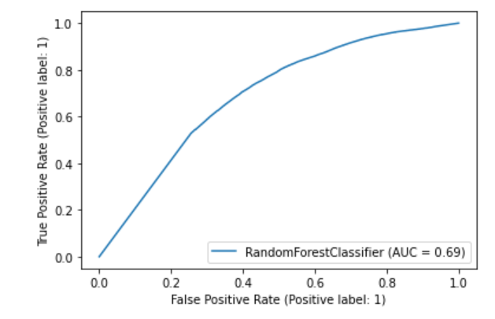
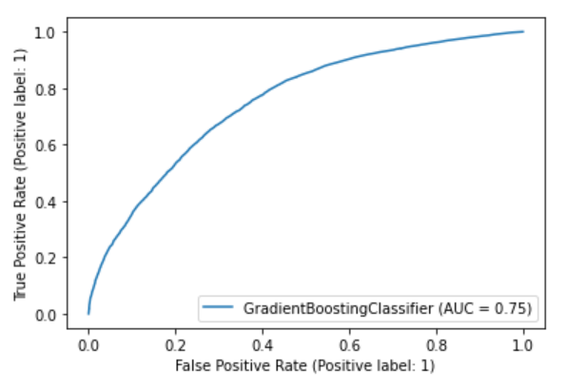
Final decisions about model
Model | Training Accuracy | Test Accuracy | CV | F-Score | AUC
Decision Tree | 0.948 | 0.866 | 0.904 | 0.927 | 0.64
Random Forest | 0.948 | 0.872 | 0.907 | 0.931 | 0.69
Gradient Boosting | 0.771 | 0.764 | 0.771 | 0.863 | 0.75
Notes:
--Put roc graphs on right of AUC score

Slide 27
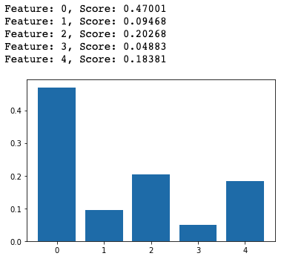
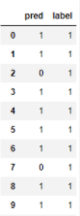
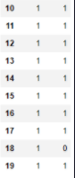
Feature Importance & Model Prediction Result
Most important Features for H1B Case Status:
Prevailing Wage : average wage paid to similarly employed workers in the requested occupation in the area of intended
Employers
Years
Job Title
Full / Part time position
Prevailing Wage
Job Title
Employers
F/ P time position
Years
Hold-out-test Result

Slide 28


Slide 29
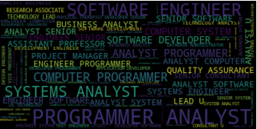
Key Findings
The most important features for H1B Case Status is Prevailing Wage；
Infosys Limited submitted the greatest number of H1-B visa applications;
Programmer Analyst is the most common Job Titles applied for by the high applicant employers;
Occupations that are in IT field with full-time position, relative high wages are more likely to qualify for an H-1 B visa.
Notes:
Key Findings: answering the questions addressed in business questions;
Key Challenges & Strategies:
•The dataset has a size of 469.45MB and more than 3 million rows, which make training and modelling costly;
•The input variables are mostly non-numeric values in object type;
•Job titles are confusable and some of the titles present differently but actually mean the same type of job;
-Dropped the outliers that located outside 25% and 75% quantiles, and improved hardware setting by using computer with GPU and CPU to run the model.
-Give each categorical value an unique number to transfer it into numeric format.
-Implemented a K-clustering model to cluster the job titles with the similar functions into one category.
Which Employers submit the most number of H-1B visa applications? Infosys Limited
What are the most common Job Titles applied for by the high applicant employers? Programmer Analyst
What occupations are more likely to qualify for an H-1 B visa? IT field, full time position, relatively high wages
Future Improvements:
[More Input Features]: The input features are limited to 11 columns, so in the future we might want to outsource more input variables from other database to improve the accuracy of prediction;
[More Careful Feature Selection]: The feature importance histogram indicates that some of the input features are not important, after we outsource more input variables we can improve the model performance by conducting a more careful feature selection.

Slide 30


Challenges and Solutions
Key Challenges
Solutions
The dataset has a size of 469.45MB and more than 3 million rows, which make training and modelling costly;
The input variables are mostly non-numeric values in object type;
Job titles are confusable and some of the titles present differently but actually mean the same type of job.
Dropped the outliers that located outside 25% and 75% quantiles, and improved hardware setting by using computer with GPU and CPU to run the model;
Give each categorical value a unique number to transfer it into numeric format;
Implemented a K-Clustering model to cluster the job titles with the similar functions into one category.
Text here
Notes:
wenti-2.pngKey Findings: answering the questions addressed in business questions;
Key Challenges & Strategies:
•The dataset has a size of 469.45MB and more than 3 million rows, which make training and modelling costly;
•The input variables are mostly non-numeric values in object type;
•Job titles are confusable and some of the titles present differently but actually mean the same type of job;
-Dropped the outliers that located outside 25% and 75% quantiles, and improved hardware setting by using computer with GPU and CPU to run the model.
-Give each categorical value an unique number to transfer it into numeric format.
-Implemented a K-clustering model to cluster the job titles with the similar functions into one category.
Which Employers submit the most number of H-1B visa applications? Infosys Limited
What are the most common Job Titles applied for by the high applicant employers? Programmer Analyst
What occupations are more likely to qualify for an H-1 B visa? IT field, full time position, relatively high wages
Future Improvements:
[More Input Features]: The input features are limited to 11 columns, so in the future we might want to outsource more input variables from other database to improve the accuracy of prediction;
[More Careful Feature Selection]: The feature importance histogram indicates that some of the input features are not important, after we outsource more input variables we can improve the model performance by conducting a more careful feature selection.

Slide 31

Future Improvements
More Input Features
The input features are limited to 11 columns, so in the future we might want to outsource more input variables from other database to improve the accuracy of prediction;
More Careful Feature Selection
The feature importance histogram indicates that some of the input features are not important, after we outsource more input variables, we can improve the model performance by conducting a more careful feature selection.
Notes:
Key Findings: answering the questions addressed in business questions;
Key Challenges & Strategies:
•The dataset has a size of 469.45MB and more than 3 million rows, which make training and modelling costly;
•The input variables are mostly non-numeric values in object type;
•Job titles are confusable and some of the titles present differently but actually mean the same type of job;
-Dropped the outliers that located outside 25% and 75% quantiles, and improved hardware setting by using computer with GPU and CPU to run the model.
-Give each categorical value an unique number to transfer it into numeric format.
-Implemented a K-clustering model to cluster the job titles with the similar functions into one category.
Which Employers submit the most number of H-1B visa applications? Infosys Limited
What are the most common Job Titles applied for by the high applicant employers? Programmer Analyst
What occupations are more likely to qualify for an H-1 B visa? IT field, full time position, relatively high wages
Future Improvements:
[More Input Features]: The input features are limited to 11 columns, so in the future we might want to outsource more input variables from other database to improve the accuracy of prediction;
[More Careful Feature Selection]: The feature importance histogram indicates that some of the input features are not important, after we outsource more input variables we can improve the model performance by conducting a more careful feature selection.

Slide 32
Thank You

